Slide 1
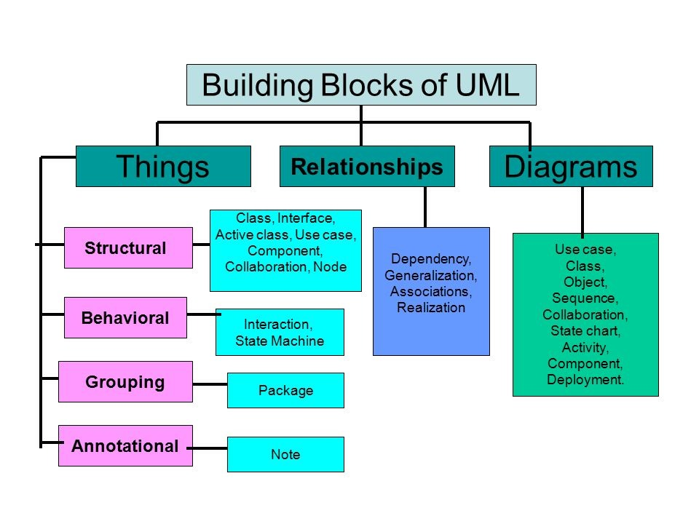

Slide 2
UML-Building Blocks
UML is composed of three main building blocks, i.e., things, relationships, and diagrams. Building blocks generate one complete UML model diagram by rotating around several different blocks. It plays an essential role in developing UML diagrams. The basic UML building blocks are listed below:
Things
Relationships
Diagrams

Slide 3
Things
Anything that is a real world entity or object is termed as things. It can be divided into several different categories:
Structural things
Behavioral things
Grouping things
Annotational things

Slide 4

Structural things define the static part of the model. They represent the physical and conceptual elements. Following are the brief descriptions of the structural things.
Class − Class represents a set of objects having similar responsibilities.

Slide 5

Interface − Interface defines a set of operations, which specify the responsibility of a class.

Slide 6

Collaboration −Collaboration defines an interaction between elements.

Slide 7

Use case −Use case represents a set of actions performed by a system for a specific goal.

Slide 8
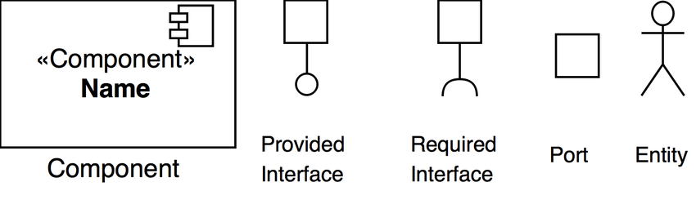
Component −Component describes the physical part of a system.

Slide 9
Relationships
It illustrates the meaningful connections between things. It shows the association between the entities and defines the functionality of an application. There are four types of relationships given below:

Slide 10
Dependency: Dependency is a kind of relationship in which a change in target element affects the source element, or simply we can say the source element is dependent on the target element. It is one of the most important notations in UML. It depicts the dependency from one entity to another.
It is denoted by a dotted line followed by an arrow at one side.

Slide 11
Association: A set of links that associates the entities to the UML model. It tells how many elements are actually taking part in forming that relationship.
It is denoted by a dotted line with arrowheads on both sides to describe the relationship with the element on both sides.

Slide 12

Generalization: It portrays the relationship between a general thing (a parent class or superclass) and a specific kind of that thing (a child class or subclass). It is used to describe the concept of inheritance.
It is denoted by a straight line followed by an empty arrowhead at one side.

Slide 13

Realization: It is a semantic kind of relationship between two things, where one defines the behavior to be carried out, and the other one implements the mentioned behavior. It exists in interfaces.
It is denoted by a dotted line with an empty arrowhead at one side.

Slide 14
Diagrams
The diagrams are the graphical implementation of the models that incorporate symbols and text. Each symbol has a different meaning in the context of the UML diagram. There are thirteen different types of UML diagrams that are available in UML 2.0, such that each diagram has its own set of a symbol. And each diagram manifests a different dimension, perspective, and view of the system.

Slide 15
UML diagrams are classified into three categories that are given below:
Structural Diagram
Behavioral Diagram
Interaction Diagram

Slide 16
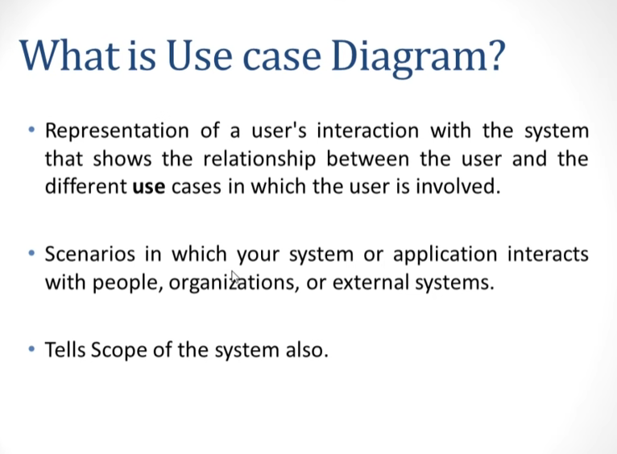

Slide 17
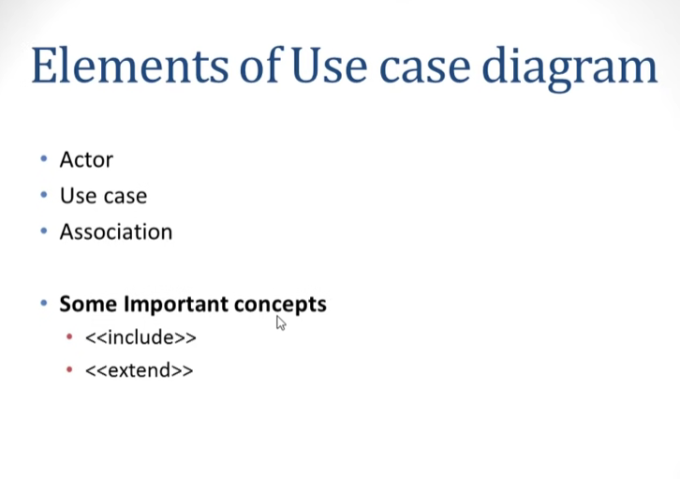

Slide 18
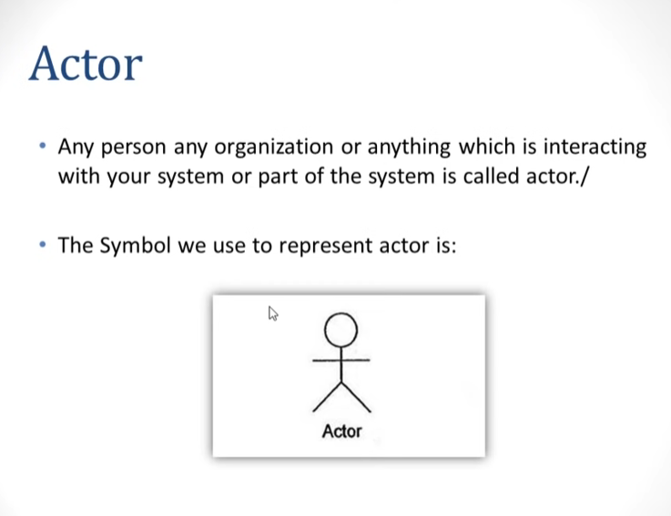

Slide 19
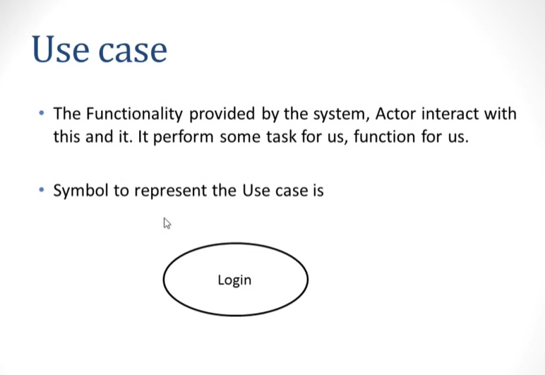

Slide 20
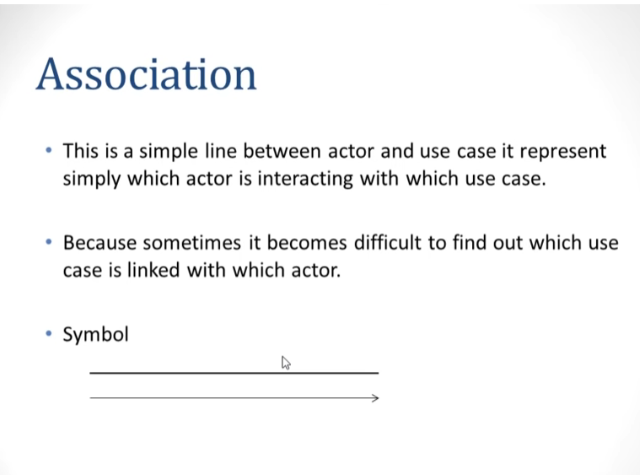

Slide 21
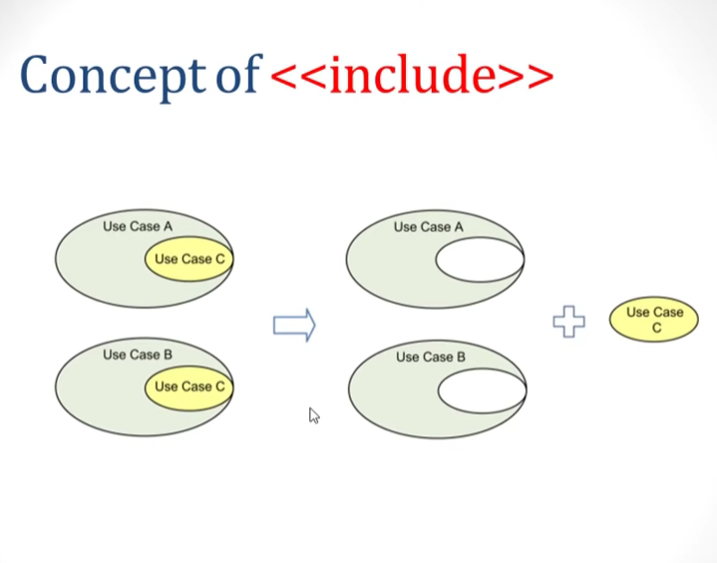

Slide 22
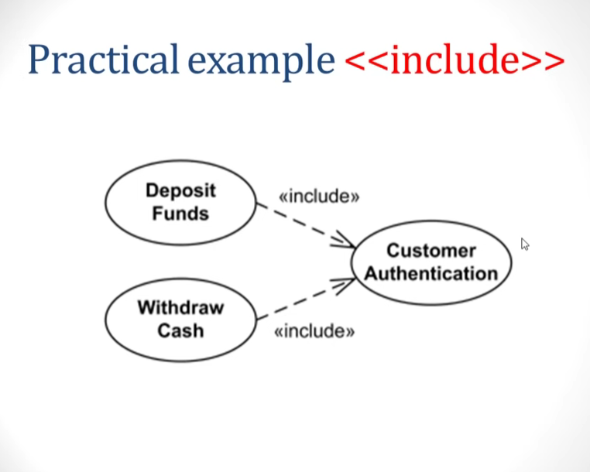

Slide 23
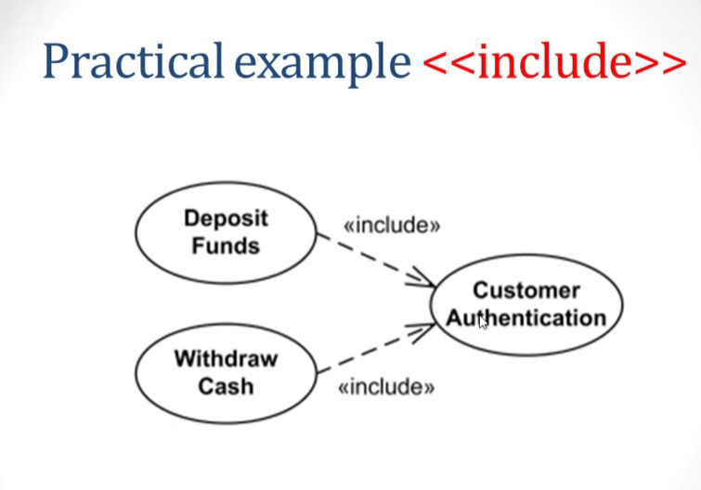

Slide 24
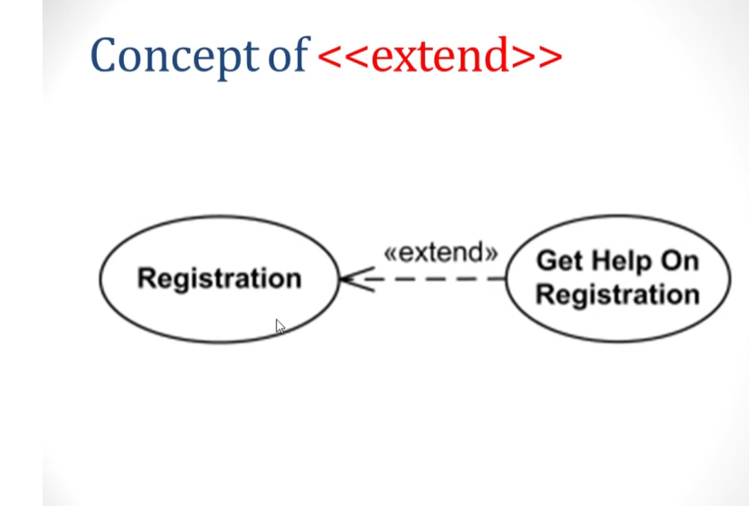

Slide 25
